Slide 1


Welcome to

Slide 2


ABOUT
THE COMPANY
Mobile-ID Technologies & Services Joint Stock Company is the potential young company with information technology activities major, established in 2016
My targeted customer is the mobile network operators, e-Service Providers, e-Government and end customers
Mobile-ID allows users to use the services requiring high security, provides digital signature services, and sign in bank, healthcare, education, e-tax declaration, e-custom, …
The scope of activities: Solutions for digital identity, secure authentication and digital signing -Trusted Hub, GoPaperless, Mobile-ID, CheckID, Facial Sense, Trusted Pay, Trusted Care, TrustedID, Trusted Kioware, X-Avenue, MRConnect, Qrypto, Blockchain Services Infrastructure, Remote Signing, Time-Stamping Authority, PKI tokens, eID cards and ePassport certificates.

Slide 3




OUR MISSION
Provided safety and high security of trusted e-identity services
Bring value-add solutions, increase profits for Certificate Provider
Efficient operation, creating added value for employees
Connecting business interests with society, protecting the environment, improving the quality of life
Towards building a sustainable business ecosystem
CUSTOMER
PARTNER
SOCIAL

Slide 4

OUR
VISION
Leading technology company in providing electronic digital signature services on smartphones and for a future paperless office

Slide 5
OUR GOALS
Building a sustainable brand
Catches the pulse of the mobile revolution
Increase revenue every year and expand company size

Slide 6
HISTORY
2016
2017
2018
2019
  Oct, 2016: Joined FIDO
  Nov, 2017: Trusted Hub software was licensed by Mobile-ID
Jul & Dec, 2018: Cooperated with EFY to launch TMS-RA system
  Dec, 2019: Cooperated with HN to golive TMS-RA
  Sept, 2016: Established
  April, 2017: Trusted Hub got FIDO UAF Server Certificate
  Mar, 2018: Trusted Hub procedure was licensed by MIC
  Oct, 2019: Associate Member of Cloud Signature Consortium
  Jan, 2018: Provided NRCA/LCA for Lao Government
  May, 2019: Collaboration with the Vietnamese Government Information Security Commission launch the MSSP service

Slide 7
HISTORY
2020
Cooperated with Softdreams to golive TMS-RA
Cooperated with CMC to golive TMS-RA and with LCS to golive TMS
Cooperated with Newtel to golive TMS-RA
Received the certificate of certified civil cryptography product for the centralized system software product Trusted Hub - Remote Signing Service, version 1.20.10.13
Cooperated with Vietnamese Government Information Security Commission to provide 60.000 PKI USIM to Ministry of Public Security for the national identity management system

Slide 8
HISTORY
2021
Received ISO/IEC 27001:2013 certificate from IAF organization
An Authorized Partner of I4P informatics and sell I4P's Trident portfolio in Vietnam (HSM, RSS, TSS, SFS, ...)
Trusted Key FIDO2, Trusted Key Bio-FIDO2, Trusted Key NFC-FIDO2, Trusted Key IE-FIDO2 and Trusted Key Allin-FIDO2 are certified by FIDO2 Authenticator Version 2.0
Our Trusted Key PKI already certified FIPS 140-2 Level 3 by NIST

Slide 9
HISTORY
2022
Cooperated with Online Vietnam to golive CA/VA/TMS-RA to support certificate provider SHA-2 I-CA
Remote signing solution have been successfully certified for Common Criteria Standards EAL 4+ by EN 419241-2:2019 and ISO/IEC 15408 Version 3.1 R5
eIDAS eID Liveness Detection compliant with ISO/IEC 30107-3 Czech accredited laboratory Tayllorcox s.r.o successfully audits eIDAS eID PAD on level 1 and 2 attacks
Cooperated with Khanh Linh Co LTD to golive CA/VA/TMS-RA to support certificate provider SHA-2 WINCA
cooperates with MBC to golive CA/VA/TMS-RA to support certificate provider SHA-2 MATBAO-CA

Slide 10
HISTORY
2023
Mobile-ID receives a business license for products that generate cryptographic keys, manage, or store cryptographic keys: Trident (including Trident HSM, Trident RSS), Entrust nShield Solo HSMs, Entrust nShield Connect HSMs
Mobile-ID cooperates with QTC to golive ID-based ecosystem
Mobile-ID cooperates with MobiFone to golive CA/VA/TMS-RA to support certificate provider SHA-2 MOBIFONE-CA
Mobile-ID cooperates with HTC to golive ID-based ecosystem

Slide 11
HISTORY
2024
Mobile-ID performed a certificate review and received certificates:
Trusted Hub Service provider Appliance QSCD (eIDAS Common Criteria Standards EAL 4+ augmented (AVA_VAN.5, ALC_FLR.3) by EN 419221-5:2018, EN 419241-2:2019 and ISO/IEC 15408 (Common Criteria) Version 3.1 Revision 5), issued by Tayllorcox
eIDAS eID module in Trusted Hub Service Provider Appliance QSCD (ISO/IEC 30107-3:2017 Biometric Presentation Attack Detection Standard and was found to be in compliance with Level 2 on the Android phones and iPhones) issued by Tayllorcox
eIDAS Regulations pursuant to Article 8, Article19 and Article 24 of the Regulation (EU) No. 910/2014 and newly by 2024/1183 of the European Parliament and of the Council of KYC/AML regulatory requirements based on ETSI EN 319 401 V3.1.1 and ETSI EN 319 411-1 V1.4.1. issued by Tayllorcox
Mobile-ID receives ISO/IEC 27001:2022 certificate from IAF organization

Slide 12
HISTORY
2025
Mobile-ID performed a certificate review and received certificates:
Mobile-ID has obtained certification for the eID module in the Trusted Hub Service Provider Appliance QSCD transition to eIDAS 2.0 with the latest version. This confirms that our company complies with "eIDAS Regulations pursuant to Article 8, Article 19, and Article 24 of Regulation (EU) No. 910/2014 and newly by 2024/1183 of the European Parliament and of the Council of KYC/AML regulatory requirements based on ETSI EN 319 401 V3.1.1 and ETSI EN 319 411-1 V1.4.1"
Mobile-ID cooperates with VNPay-CA to golive CA/VA/TMS-RA to support certificate provider SHA-2 VNPay-CA
Mobile-ID has received certificates of copyright registration for the Trusted Pay software and the GoPaperless software, issued by the Copyright Office under the Ministry of Culture, Sports, and Tourism

Slide 13




STRONG MANAGEMENT TEAM
Mr. Pham Xuan Khanh
CFO
Technical Director
Project Director
Ms. Tran Thi Van Anh
Mr. Doan Quang Tam
Mr. Duong Phuong Vu
Leads IT infrastructure creation and deployment
Manages technology implementation and control Develops IT human resources Strongly focused on front-end system
Manages R&D strategy, including HR planning
Develops and orients new technologies and services
Manages major IT projects
Create financial strategy and budgeting
Manages capital resources
Guides investment plans
Controls reporting functions

Slide 14


Our team is made up of experienced IT professionals who stay ahead of the latest trends and embrace every challenge. With creative thinking, strong technical expertise, and a collaborative spirit, we are committed to delivering optimal, efficient, and tailored technology solutions that best meet our clients' need.

Slide 15

OUR OFFERED SERVICES
CA- RA – TMS - TSA
(https://prd-tmsra.mobile-id.vn/RegistrationAuthority/)
Trusted Hub Service Provider Appliance QSCD (https://trustedhub.mobile-id.vn/)
Trusted Key PKI (https://pki.mobile-id.vn/)
Remote Signing: Selfcare, Backoffice
(https://prd-rssp.mobile-id.vn/)

Slide 16
OUR OFFERED SERVICES
GoPaperless
(https://gopaperless.mobile-id.vn/)
CheckID
(https://checkid.mobile-id.vn/)
Qrypto (https://qrypto.mobile-id.vn/)
Trusted Pay
(https://trustedpay.mobile-id.vn/)
CheckID Facialsence
(https://facialsense.mobile-id.vn/)

Slide 17
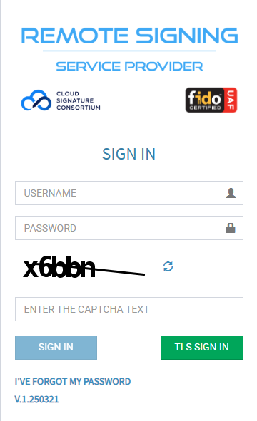
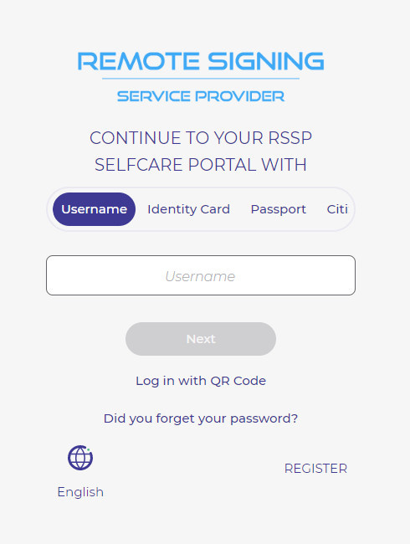
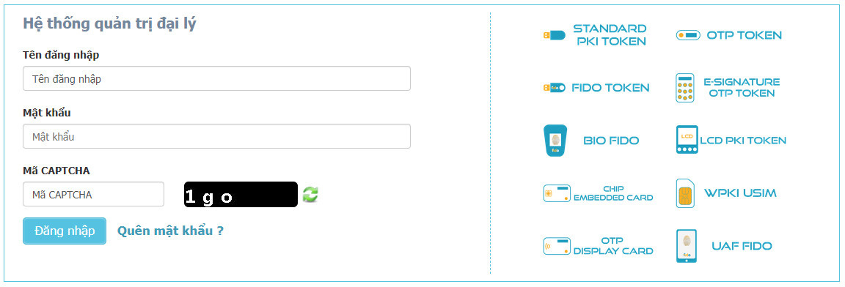
Hệ thống quản trị đại lý
Remote Signing Service Provider
Log in | Your RSSP SelfCare Portal

Slide 18



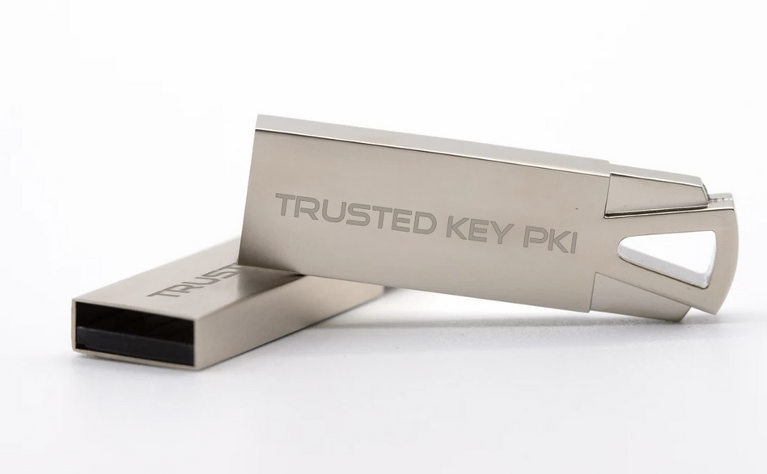
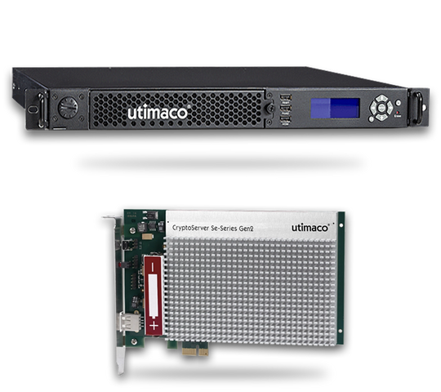
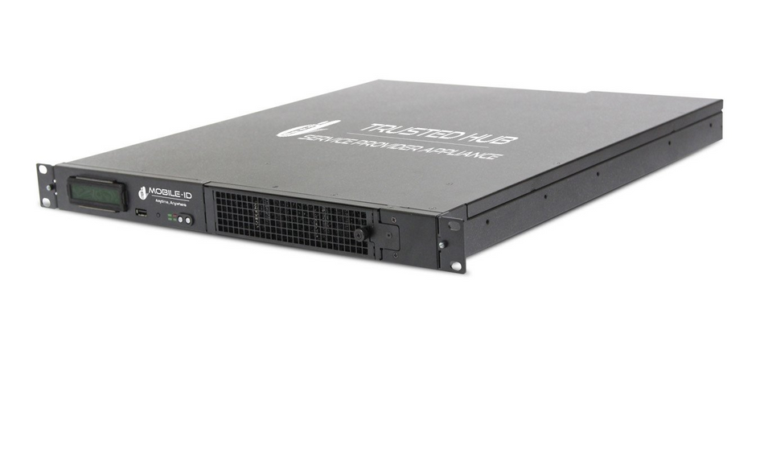
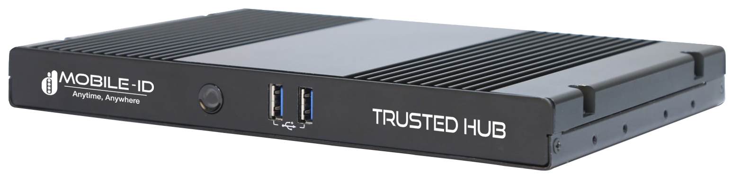
TRUSTED KEY FIDO
TRUSTED KEY PKI
TRUSTED HUB APPLIANCE

Slide 19
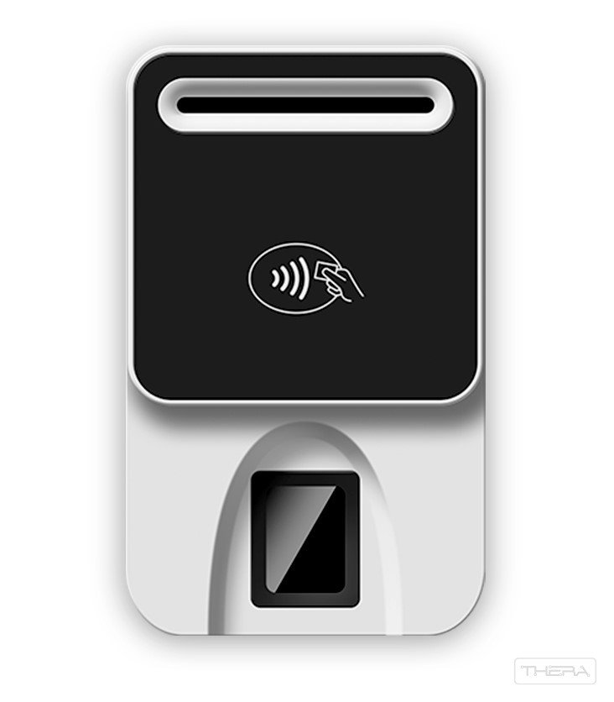
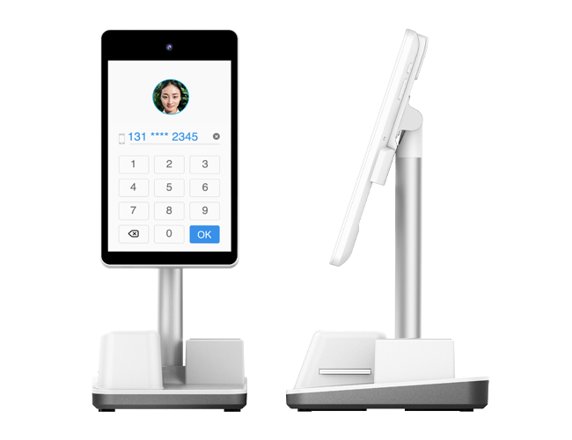
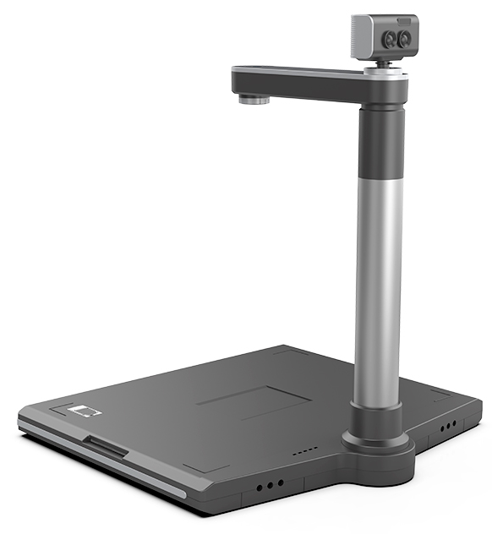
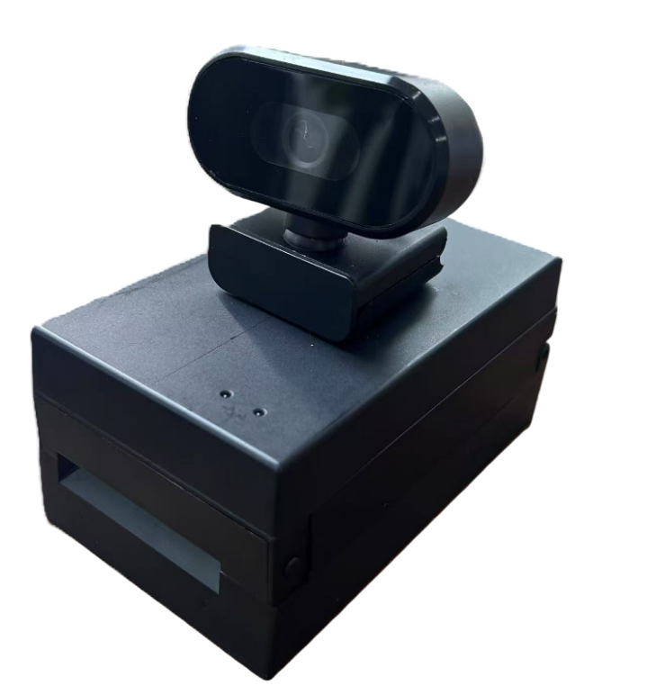
CHECKID CARD READER
BioR502
CheckID-SR
BioR502-MRZ
CheckID-ET100

Slide 20
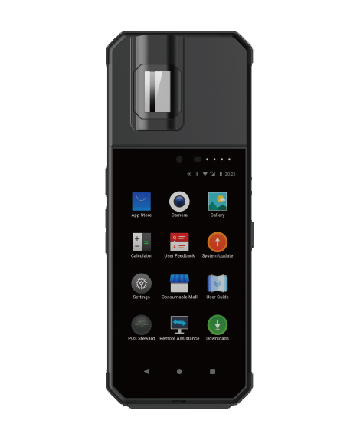
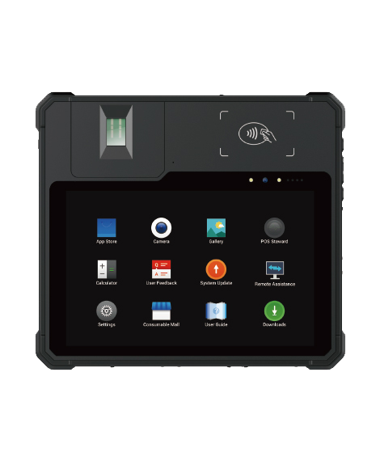

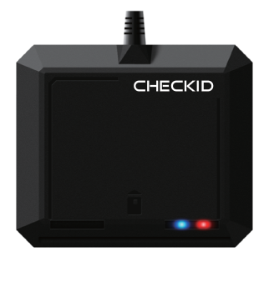
CHECKID CARD READER
CheckID-V11
CheckID-V20
CheckID-R301 C11
CheckID-R502 CL

Slide 21
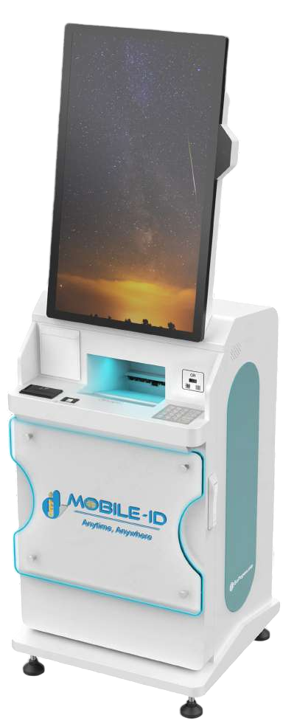
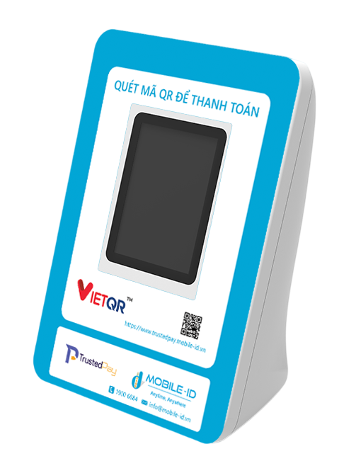
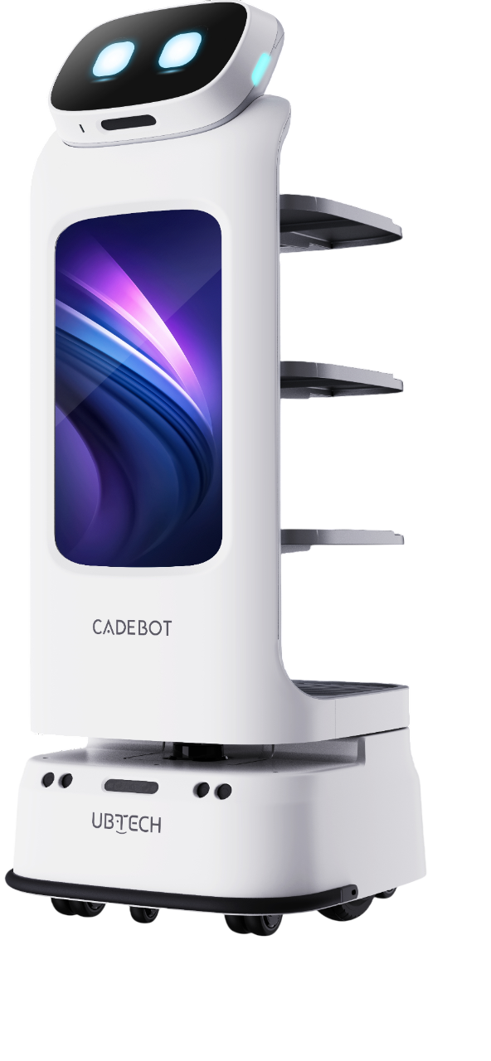
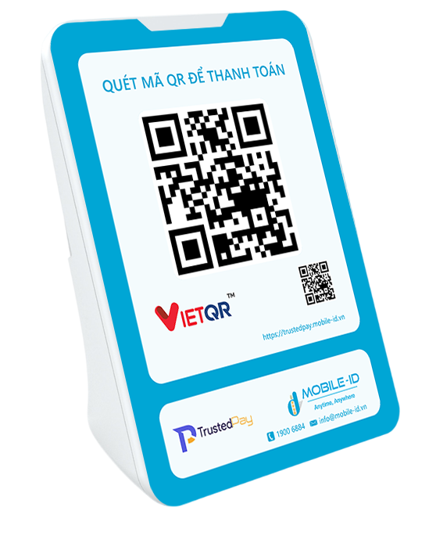
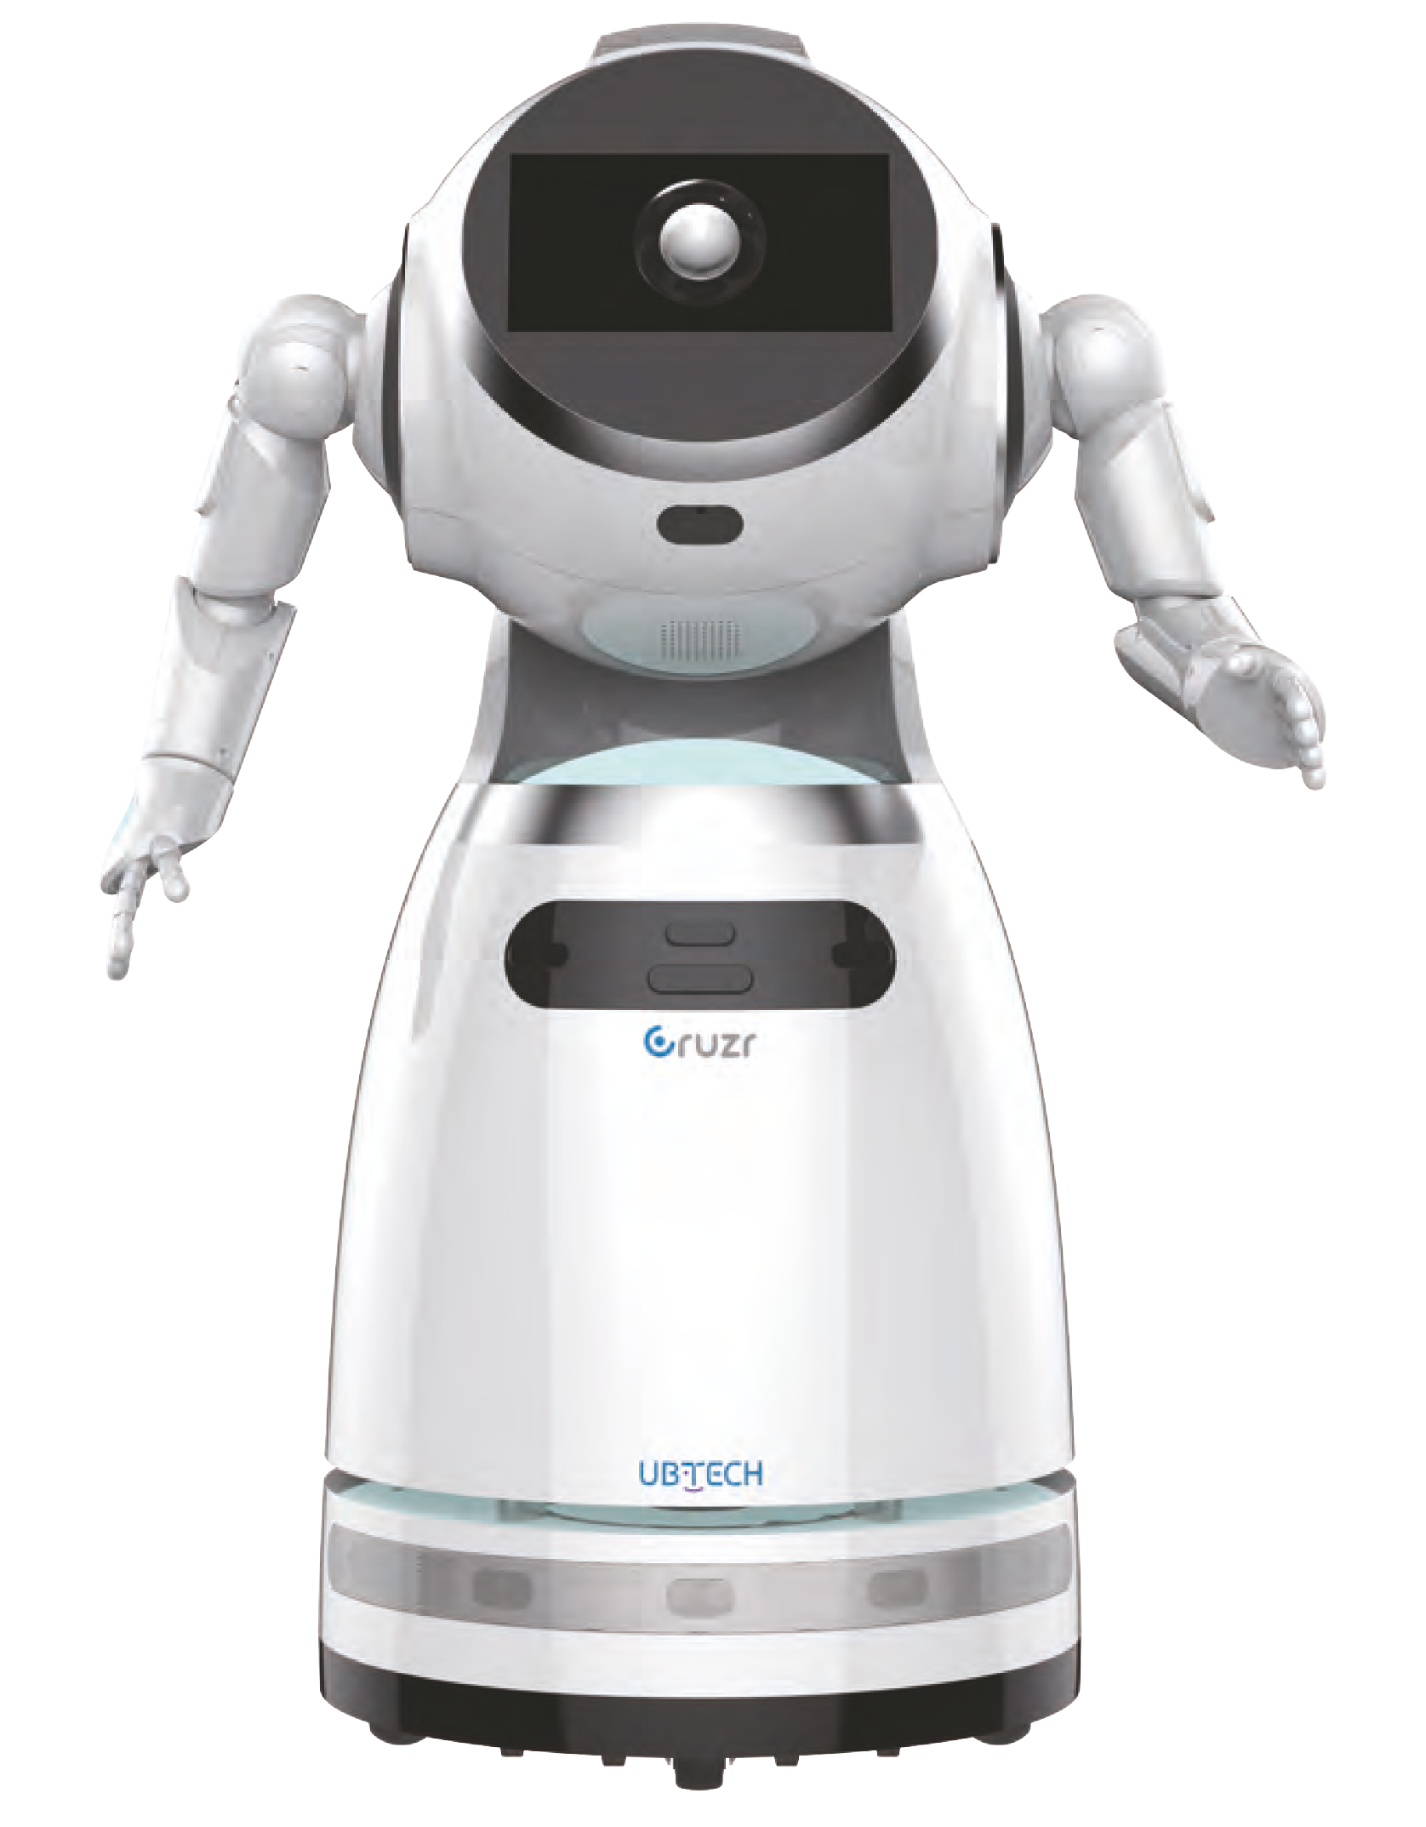
OTHER EQUIPMENT
Sound Box Trusted Pay CS89+ & CS89
Robot Cruzr
Robot Cadebot
SDK-D1090

Slide 22

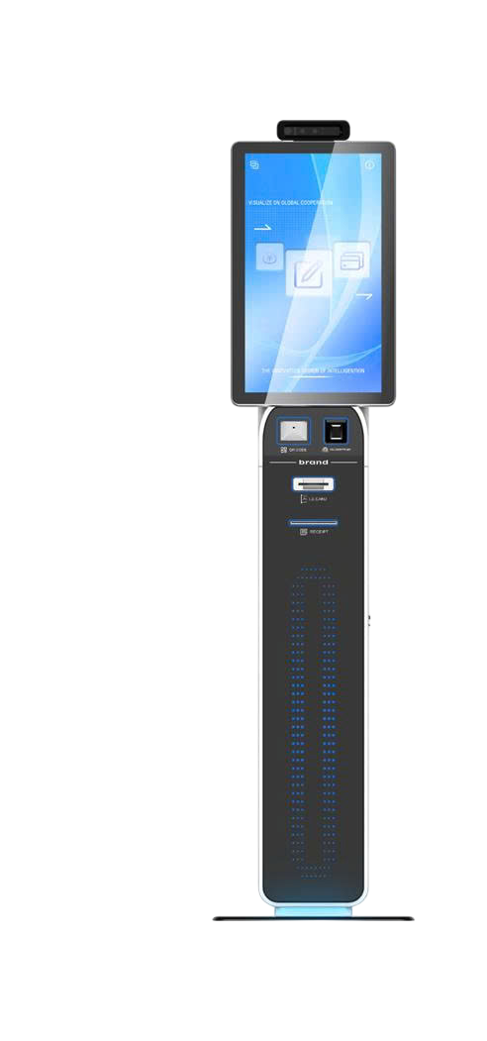
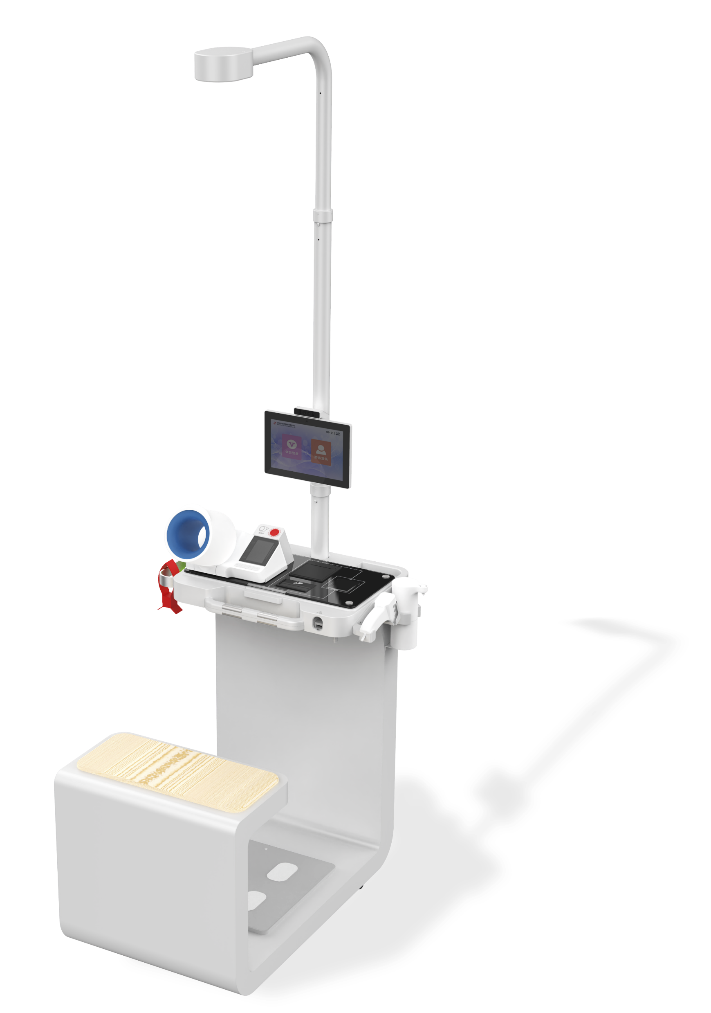
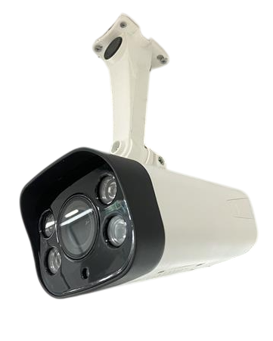
OTHER EQUIPMENT
Camera
CheckID-R77
T-301-G008 Kiosk
CheckID-D1070

Slide 23
























OUR PARTNERS
Our customers include banks, mobile network operators, educational institutions, health centers and government organizations in Vietnam

Slide 24
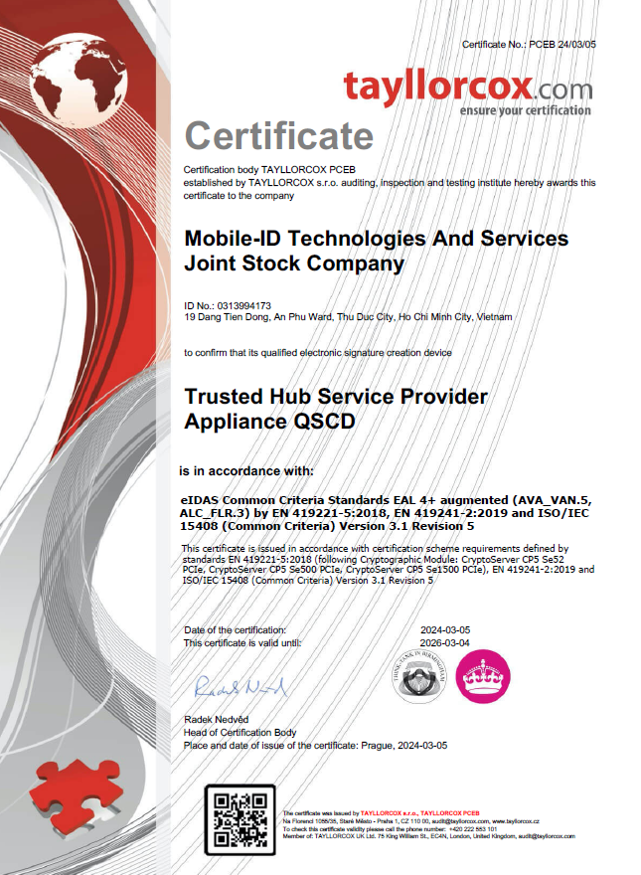
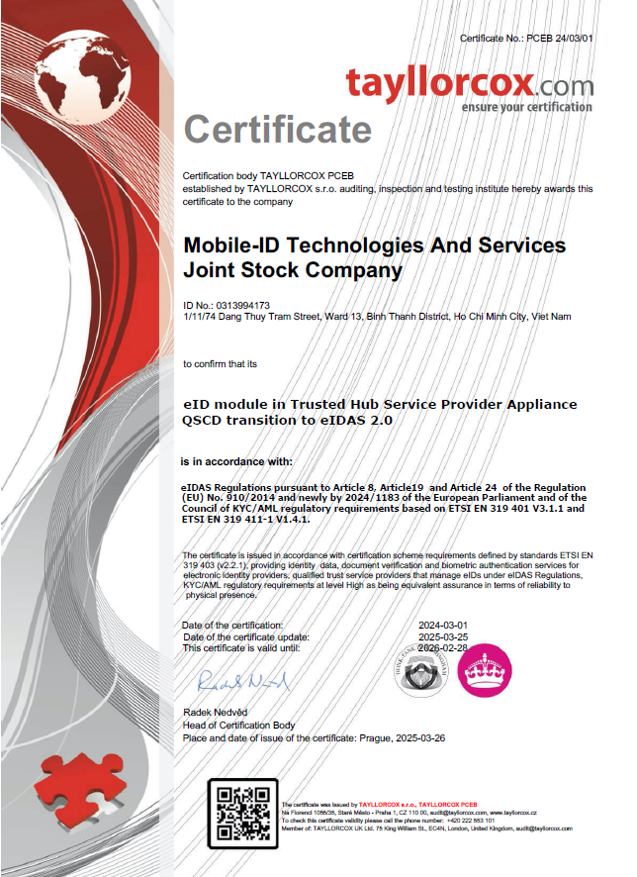
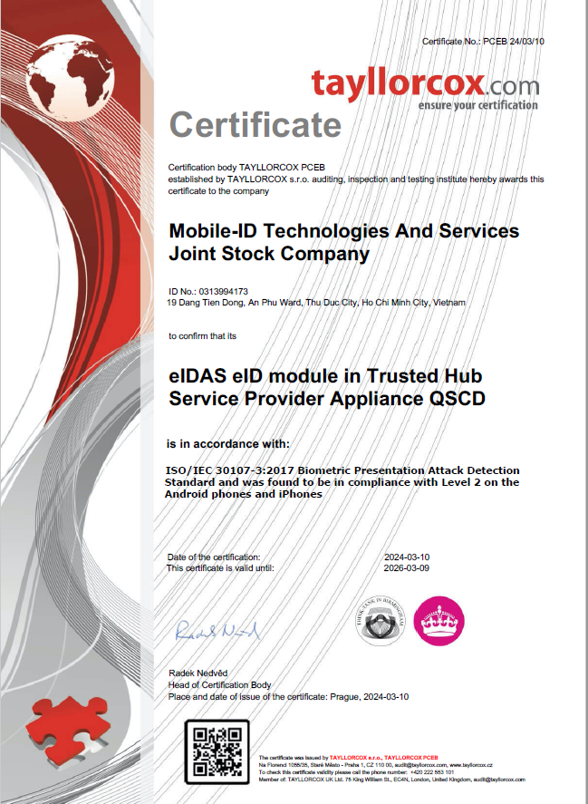
HONOURS

Slide 25
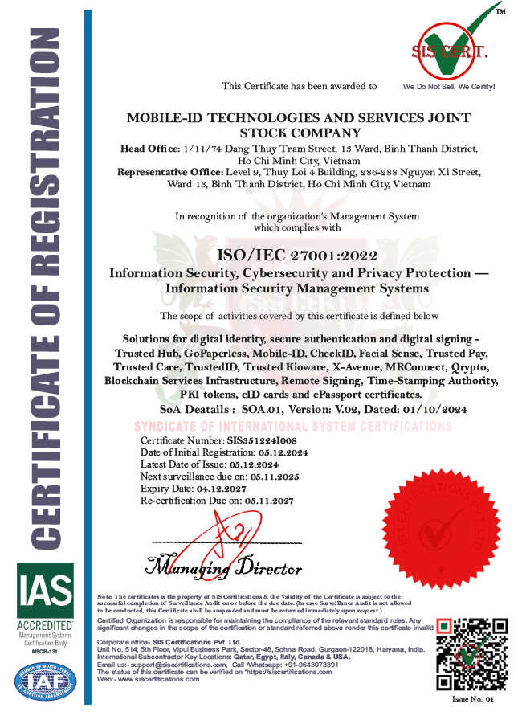

HONOURS

Slide 26





CONNECT WITH US!
MOBILE-ID TECHNOLOGIES & SERVICES JOINT STOCK COMPANY
Level 9, Thuy Loi 4 Building, 286-288 Nguyen Xi Street, Binh Loi Trung Ward, Ho Chi Minh City, Vietnam
028 3622 2982
info@mobile-id.vn

